Slide 1
Software Design and Architecture
Introduction to Refactoring

Slide 2
What is Refactoring
Refactoring is the process of changing a software system such that
the external behavior of the system does not change
e.g. functional requirements are maintained
but the internal structure of the system is improved
This is sometimes called
“Improving the design after it has been written”

Slide 3
The idea behind refactoring is to acknowledge that it will be difficult to get a design right the first time and, as a program’s requirements change, the design may need to change
refactoring provides techniques for evolving the design in small incremental steps

Slide 4
(Very) Simple Example
Consolidate Duplicate Conditional Fragments; This
if (isSpecialDeal()) {
total = price * 0.95;
send()
} else {
total = price * 0.98;
send()
}
becomes this
if (isSpecialDeal()) {
total = price * 0.95;
} else {
total = price * 0.98;
}
send();

Slide 5
(Another) Simple Example
Replace Magic Number with Symbolic Constant
double potentialEnergy(double mass, double height) {
return mass * 9.81 * height;
}
becomes this
double potentialEnergy(double mass, double height) {
return mass * GRAVITATIONAL_CONSTANT * height;
}
static final double GRAVITATIONAL_CONSTANT = 9.81;

Slide 6
Refactoring is thus Dangerous!
Manager’s point-of-view
If my programmers spend time “cleaning up the code” then that’s less time implementing required functionality (and my schedule is slipping as it is!)
Refactoring needs to be systematic, incremental, and safe

Slide 7
Refactoring Benefits
Often code size is reduced after a refactoring
Confusing structures are transformed into simpler structures
which are easier to maintain and understand

Slide 8
A “cookbook” can be useful
Refactoring: Improving the Design of Existing Code
by Martin Fowler (and Kent Beck, John Brant, William Opdyke, and Don Roberts)
Similar to the Gang of Four’s Design Patterns
Provides “refactoring patterns”

Slide 9
Principles in Refactoring
Fowler’s definition
Refactoring (noun)
a change made to the internal structure of software to make it easier to understand and cheaper to modify without changing its observable behavior
Refactoring (verb)
to restructure software by applying a series of refactorings without changing its observable behavior

Slide 10
Principles in Refactoring
The purpose of refactoring is
to make software easier to understand and modify
contrast this with performance optimization
again functionality is not changed, only internal structure;
however performance optimizations often involve making code harder to understand (but faster!)

Slide 11
Useful Reference for Code Performance Optimization
Code Complete: A Practical Handbook of Software Construction, Second Edition 2nd Edition

Slide 12
Principles in Refactoring
When you systematically apply refactoring, you wear two hats
adding function
functionality is added to the system without spending any time cleaning the code
refactoring
no functionality is added, but the code is cleaned up, made easier to understand and modify, and sometimes is reduced in size

Slide 13
How do you make refactoring safe?
First, use refactoring “patterns”
Fowler’s book assigns “names” to refactorings in the same way that the GoF’s book assigned names to patterns

Slide 14
How do you make refactoring safe?
Second, test constantly!
This ties into the agile design paradigm
you write tests before you write code
after you refactor, you run the tests and check that they all pass
if a test fails, the refactoring broke something but you know about it right away and can fix the problem before you move on

Slide 15
Why should you refactor?
Refactoring improves the design of software
without refactoring, a design will “decay” as people make changes to a software system
Refactoring makes software easier to understand
because structure is improved, duplicated code is eliminated, etc.

Slide 16
Why should you refactor?
Refactoring helps you find bugs
Refactoring promotes a deep understanding of the code at hand, and this understanding aids the programmer in finding bugs and anticipating potential bugs
Refactoring helps you program faster
because a good design enables progress

Slide 17
When should you refactor?
Refactor when you add functionality
do it before you add the new function to make it easier to add the function
or do it after to clean up the code after the function is added
Refactor when you need to fix a bug
Refactor as you do a code review

Slide 18
Problems with Refactoring
Business applications are often tightly coupled to underlying databases
code is easy to change; databases are not
Changing Interfaces (!!)
Some refactorings require that interfaces be changed
if you own all the calling code, no problem
if not, the interface is “published” and can’t change
Major design changes cannot be accomplished via refactoring
This is why agile design says that software devs. need courage!

Slide 19
Refactoring: Where to Start?
How do you identify code that needs to be refactored?
Fowler uses an olfactory analogy (attributed to Kent Beck)
Look for “Bad Smells” in Code
A very valuable chapter in Fowler’s book
It presents examples of “bad smells” and then suggests refactoring techniques to apply

Slide 20
Bad Smells in Code
Duplicated Code
bad because if you modify one instance of duplicated code but not the others, you (may) have introduced a bug!
Long Method
long methods are more difficult to understand
performance concerns with respect to lots of short methods are largely obsolete

Slide 21
Bad Smells in Code
Large Class
Large classes try to do too much, which reduces cohesion
Long Parameter List
hard to understand, can become inconsistent if the same parameter chain is being passed from method to method
Divergent Change
symptom: one type of change requires changing one subset of methods; another type of change requires changing another subset
Related to cohesion

Slide 22
Bad Smells in Code
Shotgun Surgery
a change requires lots of little changes in a lot of different classes
Feature Envy
A method requires lots of information from some other class
Data Clumps
attributes that clump together (are used together) but are not part of the same class

Slide 23
Bad Smells in Code
Primitive Obsession
characterized by a reluctance to use classes instead of primitive data types
Switch Statements
Switch statements are often duplicated in code; they can typically be replaced by use of polymorphism (let OO do your selection for you!)
Parallel Inheritance Hierarchies
Similar to Shotgun Surgery; each time we add a subclass to one hierarchy, we need to do it for all related hierarchies
Note: some design patterns encourage the creation of parallel inheritance hierarchies (so they are not always bad!)

Slide 24
Bad Smells in Code
Lazy Class
A class that no longer “pays its way”
e.g. may be a class that was downsized by a previous refactoring, or represented planned functionality that did not pan out
Speculative Generality
“Oh we think we need the ability to do this kind of thing someday”
Temporary Field
An attribute of an object is only set/used in certain circumstances;
but an object should need all of its attributes

Slide 25
Bad Smells in Code
Message Chains
a client asks an object for another object and then asks that object for another object etc. Bad because client depends on the structure of the navigation
Middle Man
If a class is delegating more than half of its responsibilities to another class, do you really need it? Involves trade-offs, some design patterns encourage this (e.g. Decorator)
Inappropriate Intimacy
Pairs of classes that know too much about each other’s implementation details (loss of encapsulation; change one class, the other has to change)

Slide 26
Bad Smells in Code
Data Class (information holder)
These are classes that have fields, getting and setting methods for the fields, and nothing else; they are data holders, but objects should be about data AND behavior
Refused Bequest
A subclass ignores most of the functionality provided by its superclass
Subclass may not pass the “IS-A” test
Comments (!)
Comments are sometimes used to hide bad code
“…comments often are used as a deodorant” (!)

Slide 27
The Catalog
The refactoring book has 72 refactoring patterns!
Some of common ones:
Extract Method
Replace Temp with Query
Move Method
Replace Conditional with Polymorphism
Introduce Null Object
Separate Query for Modifier
Introduce Parameter Object
Encapsulate Collection
Replace Nested Conditional with Guard Clauses

Slide 28
Extract Method
• You have a code fragment that can be grouped together
• Turn the fragment into a method whose name explains the purpose of the
fragment

Slide 29
Example

Slide 30
Replace Temp with Query
You are using a temporary variable to hold the result of an expression
Extract the expression into a method;
Replace all references to the temp with the expression.
The new method can then be used in other methods

Slide 31
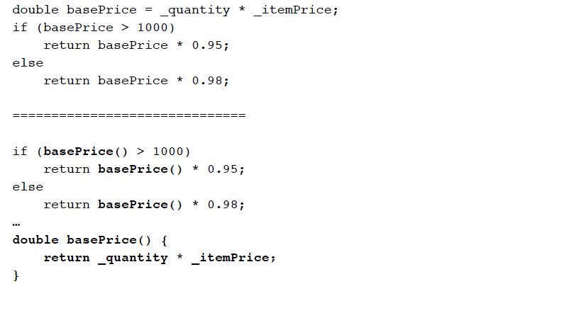
Example

Slide 32
Move Method
A method is using more features (attributes and operations) of another class than the class on which it is defined
Create a new method with a similar body in the class it uses most. Either turn the old method into a simple delegation, or remove it altogether

Slide 33
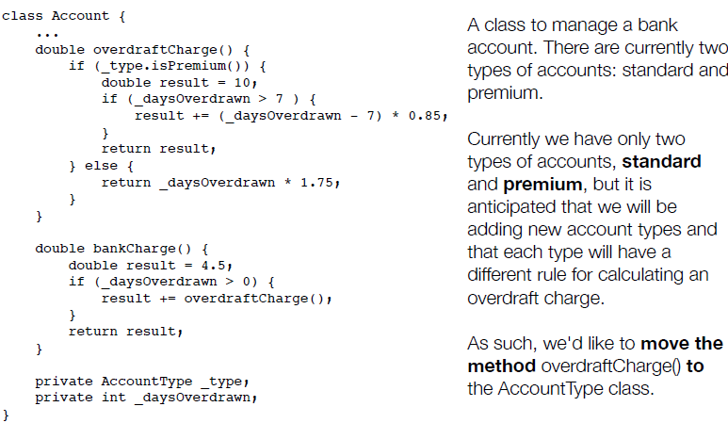
Move Method

Slide 34
Move Method
When moving a method to a new class, we examine its code to see if makes use of internal attributes of its original class
In this case, overdraftCharge() makes use of _daysOverdrawn
All such attributes become parameters to the method in its new home. (If the method already had parameters, the new parameters get tacked on to the end of its existing parameter list.)
In this case, _daysOverdrawn will stay in the Account class and be passed as a parameter to AccountType.overdraftCharge().

Slide 35
Move Method
Note, also, that since we are moving this method to the AccountType class, all calls to its methods that previously required a variable reference, can now be made directly
Thus, _type.isPremium() becomes simply isPremium() in the method’s new home

Slide 36
Move Method
Here is the method in its new home. It has a daysOverdrawn parameter, which is used instead of _daysOverdrawn, throughout the method.
_type.isPremium() is now just isPremium(), as advertised.

Slide 37
Move Method
Back in the Account class, we update overdraftCharge() to delegate to the overdraftCharge() method in the AccountType class. Or, we could…

Slide 38
Move Method
… get rid of the overdraftCharge() method in Account entirely. In that case, we move the call to AccountType.overdraftCharge() to bankCharge()

Slide 39
Replace Conditional with Polymorphism
You have a conditional that chooses different behavior depending on the type of an object
Move each “leg” of the conditional to an overriding method in a subclass. Make the original method abstract

Slide 40
Replace Conditional with Polymorphism

Slide 41
Replace Conditional with Polymorphism
With this configuration, you can now write code that looks like this:
and everything will work correctly via polymorphism and will be easy to extend: just add a new subclass to support a new type of bird

Slide 42
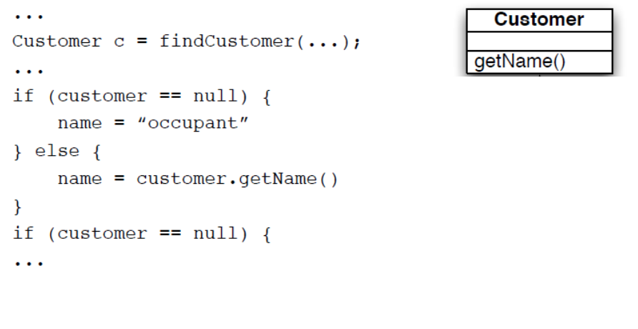
Introduce Null Object
Repeated checks for a null value (see below)
Rather than returning a null value from findCustomer() return an instance of a “null customer” object

Slide 43
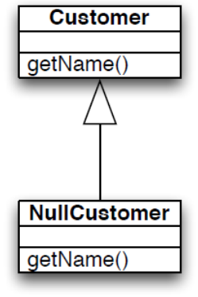
Introduce Null Object
The conditional goes away entirely!!

Slide 44
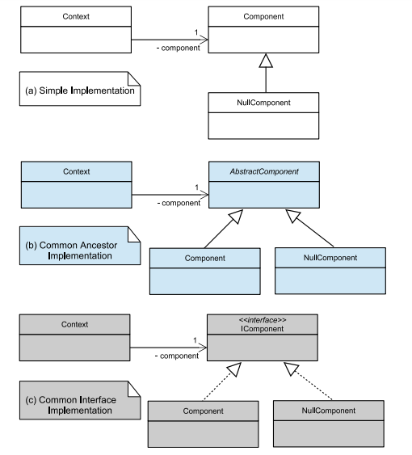
Null Object Design Pattern

Slide 45
Separate Query for Modifier
Sometimes you will encounter code that does something like this
getTotalOutstandingAndSetReadyForSummaries()
It is a query method but it is also changing the state of the object being called
This change is known as a “side effect” because it’s not the primary purpose of the method

Slide 46
Separate Query for Modifier
It is generally accepted practice that queries should not have side effects so this refactoring says to split methods like this into:
getTotalOutstanding()
setReadyForSummaries()
Try as best as possible to avoid side effects in query methods

Slide 47
Introduce Parameter Object
You have a group of parameters that go naturally together
Stick them in an object and pass the object
Imagine methods like
amountInvoicedIn(start: Date; end: Date);
amountOverdueIn(start: Date; end: Date);
This refactoring says replace them with something like
amountInvoicedIn(dateRange: DateRange)
The new class starts out as a data holder but will likely attract methods to it

Slide 48
Encapsulate Collection
A method returns a collection
Make it return a read-only version of the collection and provide add/remove methods
Student class with
getCourses(): Map;
setCourses(courses: Map);
Change to
getCourses(): ReadOnlyList
addCourse(c : Course)
removeCourse(c : Course)
Changing the externally visible collection, too, is a good idea to protect clients from depending on the internals of the Student class

Slide 49
Replace Nested Conditional with Guard Clauses
This refactoring relates to the purpose of conditional code
One type of conditional checks for a variation in “normal” behavior
The system will either do A or B, both are considered “normal” behavior
The other type of conditional checks for unusual circumstances that require special behavior; if all of these checks fail then the system proceeds with “normal behavior”
We want to apply this refactoring when we discover the latter type of conditional

Slide 50
Example
Note: This type of code may be the result of a novice programmer or due to a programming constraint imposed by
some companies that a method can only have a single return.
Often this constraint
causes more confusion
than its worth

Slide 51
Example
double getAmount() {
if (_isDead) return deadAmount();
if (_isSeparated) return separatedAmount();
if (_isRetired) return retiredAmount();
return normalAmount();
}
With this refactoring, all of the code trying to identify special
conditions are turned into one-line statements that determine whether the condition applies and if so handles it
That’s why these statements are called “guard clauses”
Even though this method has four returns, its easier to
understand than the method before the refactoring

Slide 52
Common Situation: Need to reverse conditionals
Sometimes complex compound conditionals can be converted into guard clauses by reversing the condition that is being tested
By reversing the conditionals and “failing early” you simplify the code

Slide 53
Example

Slide 54
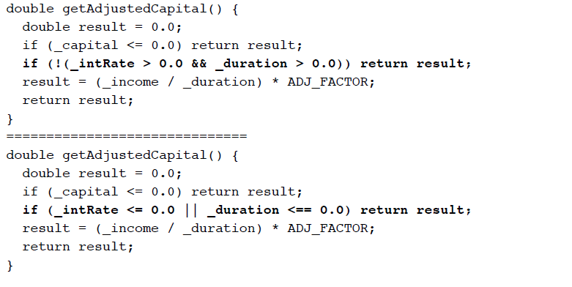
Example

Slide 55
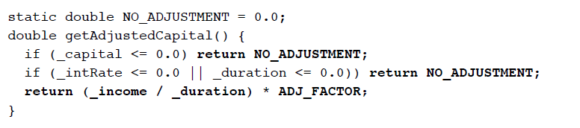
Example
In this final step
we can eliminate the temporary variable altogether,
replace 0.0 with a constant that provides semantic meaning, and just return the adjusted capital without storing it in a temp first.
The resulting method is simpler, shorter, easier to understand

